Slide 1
English Phonetics
ENGL-437
2021 Spring

Slide 2
English consonants & vowels

Slide 3
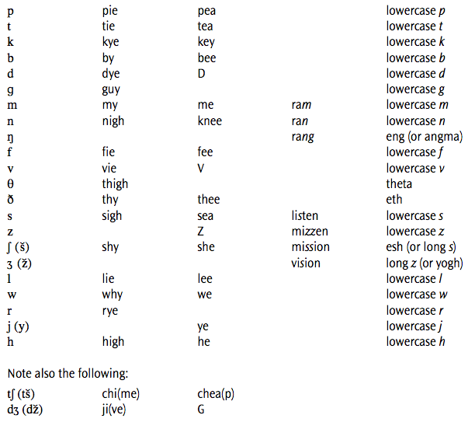
English consonants

Slide 4
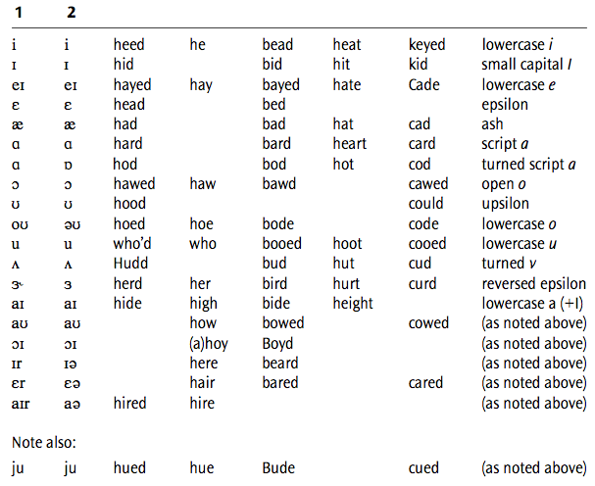
English vowels
monophthongs
diphthongs

Slide 5
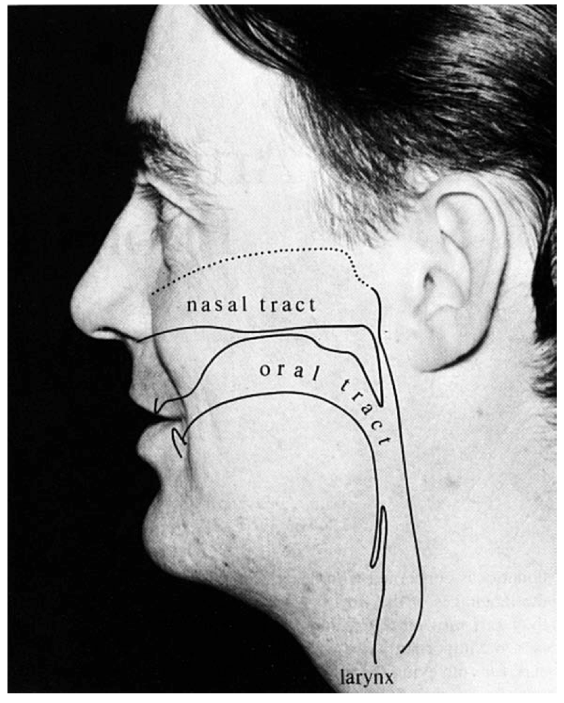
The vocal tract
鼻
耳
咽
喉

Slide 6
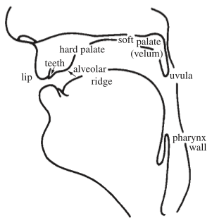
Vocal tract (upper)

Slide 7
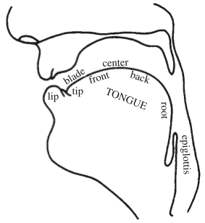
Vocal tract (lower)

Slide 8
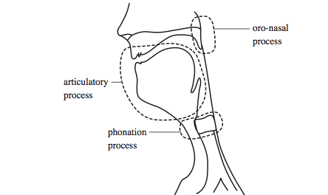
5 speech organs =constrictors =articulators
velum
= soft palate
lips
tongue
body
tongue
tip
larynx
= voicebox

Slide 9
Phonation process in larynx

Slide 10
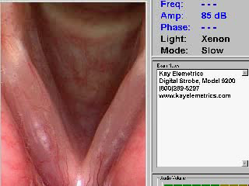
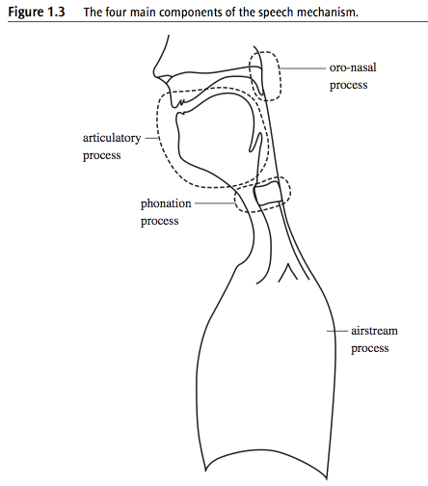
Vocal cords vibration

Slide 11
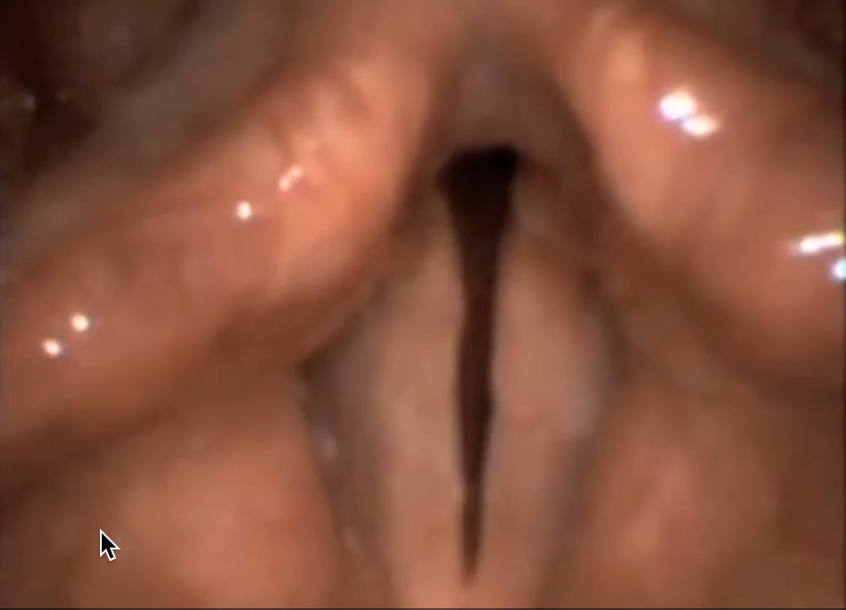
Slow motion of vocal cords vibration

Slide 12
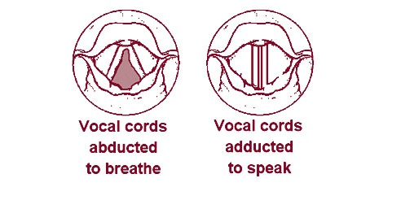
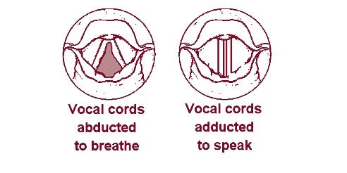
Larynx = voicebox
voiced: can feel vibration
e.g. v, z, l, m, a, i, …
voiceless: can’t feel vibration
e.g. f, s, k, p, h, …

Slide 13
Oro-nasal process in velum

Slide 14
Whether velum lowered
nasals: m n ng …
when breathing?
up
down

Slide 15
Articulatory process in lips / tongue tip / tongue body

Slide 16
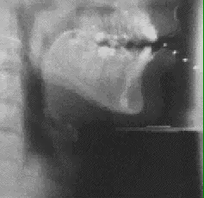
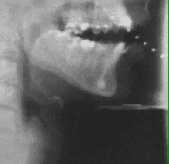
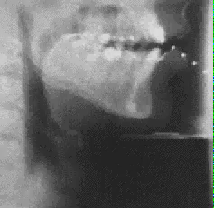
lips
tongue tip
tongue body

Slide 17
Phonemes
Individual sounds that form words
e.g., ‘psycho’ /s aɪ k oʊ/
a combination of speech organs’ actions
lips / tongue tip / tongue body / velum / larynx
phonemes
on
on
on
on
on
p,b,m,f,v,w
θ,ð,t,d,s,z,ʃ,ʒ,l,r
k,g,ŋ,j,vowels
m,n,ŋ
p,f,θ,t,s,ʃ,k,h

Slide 18
Acoustics

Slide 19
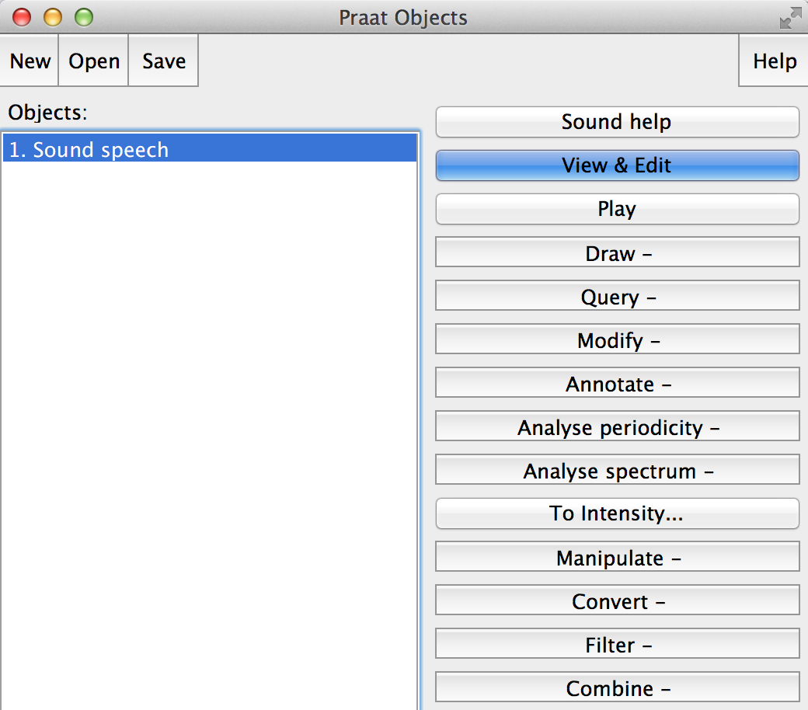
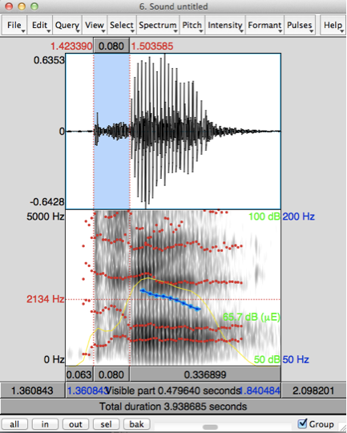
Acoustics in Praat
duration (sec.)
waveform
pitch (Hz)
spectrogram
formant (Hz)
intensity (dB)

Slide 20
Praat
Duration:
select (click and drag on waveform or spectrogram)
read a value (sec.) on the top
zoom in (if not visible)

Slide 21
Praat
Intensity:
show intensity
click on green
read a value (dB) on the right

Slide 22
Praat
Pitch:
show pitch
pitch setting - pitch range
65-200Hz for male speech
145-275Hz for female speech
click on blue
read a value (Hz) on the right

Slide 23
Praat
Formant:
show formants
place the cursor on one of the trajectories
read a value (Hz) on the left

Slide 24
Vowel acoustics
Record yourself with the vowel /a/
Measure pitch using Praat
The number of occurrences of a repeating event per second (Hz)
repeating event = vibration of vocal folds
Repeating? This might remind you of a sine wave!
Let’s create a sine wave (=pure tone) with the same frequency using Praat
Why different in sound quality?
Source & Filter

Slide 25

Source
Sound at larynx
Listen to a sentence from a SiSwati
(Southern Bantu Language; Swaziland)
Listen to the glottal wave recorded from subject's larynx while the sentence is being produced
Doesn’t sound like a pure or simplex tone
A complex tone

Slide 26
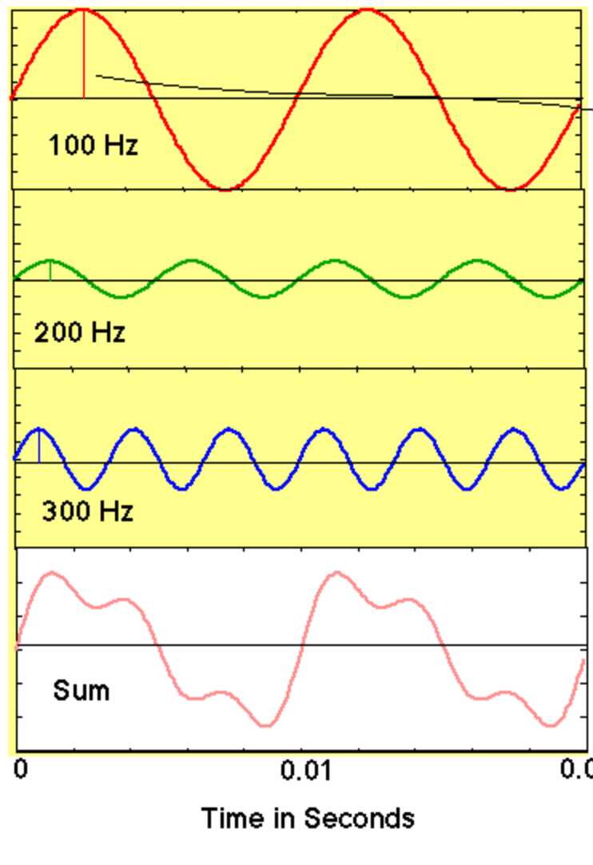
Complex tone in spectrum
Fundamental frequency (F0)
Amplitude
100
Frequency(Hz)
Amplitude
200
Frequency(Hz)
harmonics
Amplitude
300
Frequency(Hz)
Amplitude
100
200
300
Frequency(Hz)

Slide 27
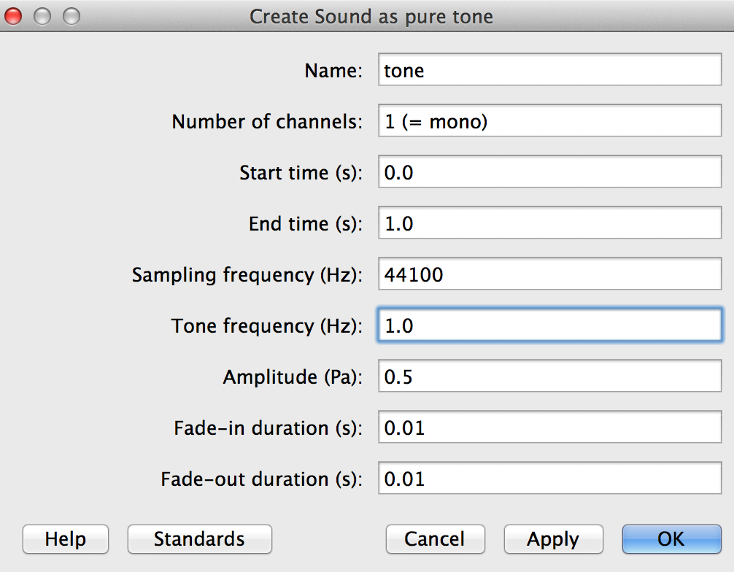
Practice with pure tone & spectrum

Slide 28
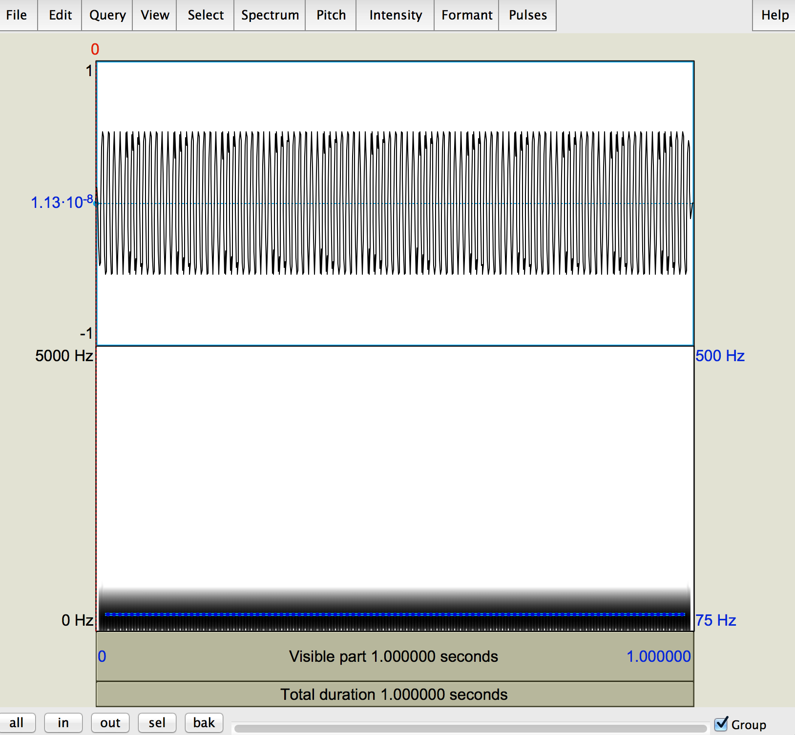
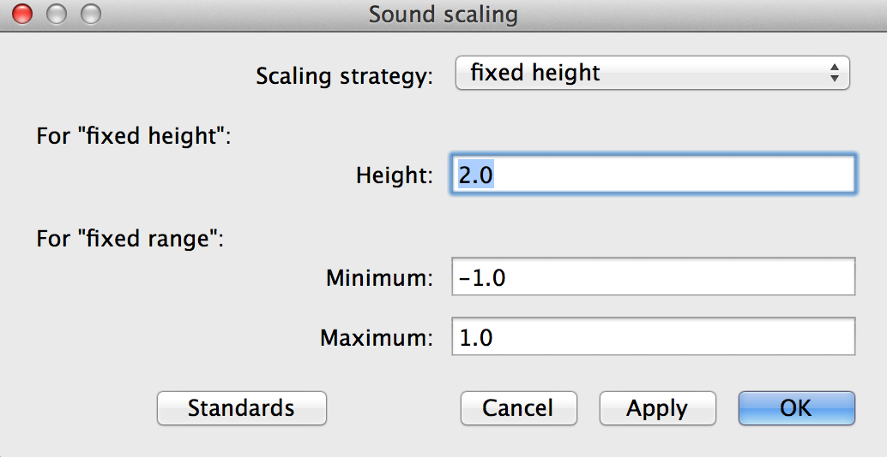
Practice with pure tone & spectrum
View:Sound scaling

Slide 29
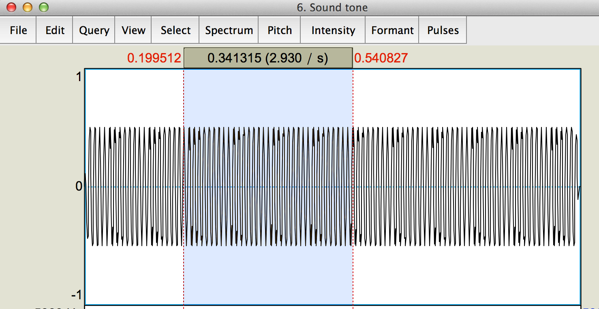
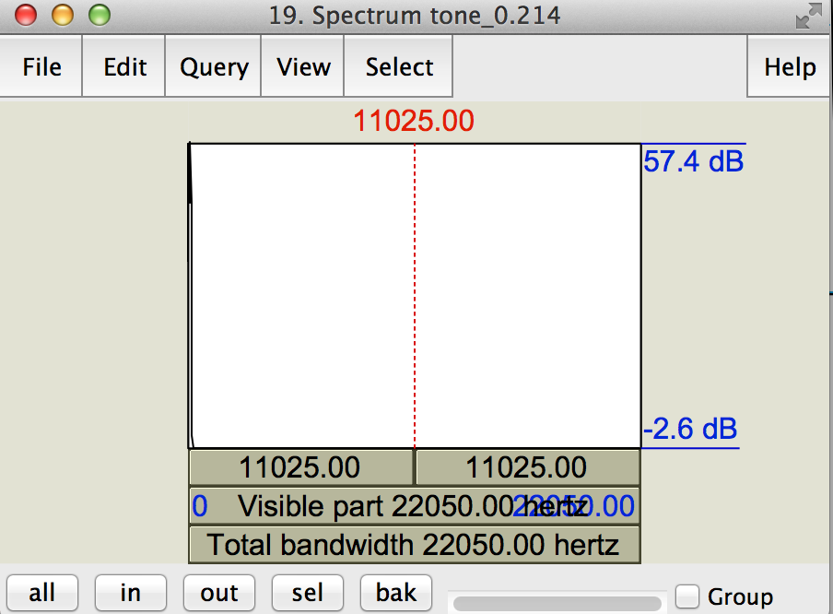
Practice with pure tone & spectrum
Select at least several cycles
Spectrum:Spectral slice
View:Zoom
From 0 to 3000

Slide 30
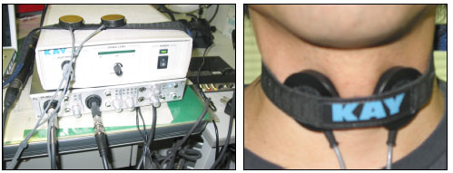
Human voice source
Measured by ElectroGlottoGraph (EGG)
Open vowelEGG.collection in Praat
Compare spectrums between EGG and audio

Slide 31
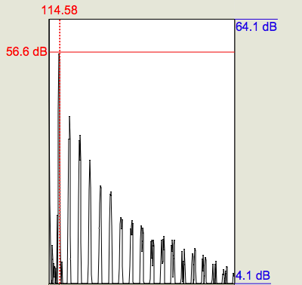
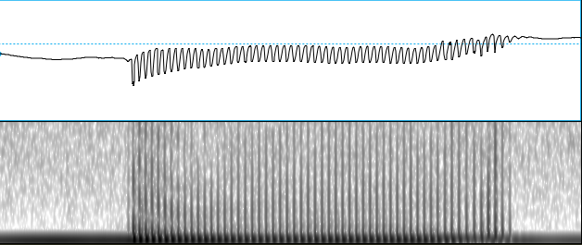
Human voice source
Select several cycles
Spectrum:Spectral slice
F0
x2
x3
amplitude
x4
x5
x6
x7
x8
x9
x10
…….
frequency
gradually decreasing

Slide 32
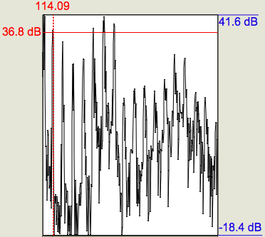
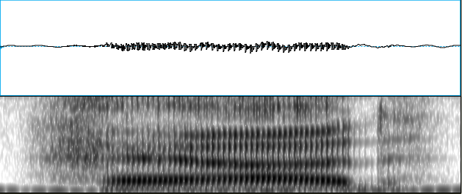
Filtered by vocal tract
Select several cycles
Spectrum:Spectral slice
x6
x7
F0
x5
x2
…….
x4
x3
x9
x8
x10
amplitude
frequency
Jigjagging
with peaks and valleys

Slide 33
source & filter
amplitude
frequency
filtered=carved

Slide 34
source
Human voice source consists of harmonics
A complex tone = sum of pure tones at integer multiples of the lowest pure tone
the lowest pure tone
Fundamental frequency (F0)
rate of vibration of the larynx
the number of opening-closing cycles of the larynx per second
Amplitude of pure tones gradually decreases
Amplitude
100
200
300
400
500
600
700
800
Frequency(Hz)

Slide 35
filter
Compare spectrums between audio and EGG
EGG: gradual decreasing
audio: peaks/mountains and valleys
Because it is filtered by the vocal tract (VT)
peaks/mountains: frequencies VT likes = formants
valleys: frequencies VT does NOT like

Slide 36
Synthesizing Source
Praat allows one to synthesize Source
Create harmonics from 100Hz to 1000Hz
with decreasing amplitude by .05

Slide 37
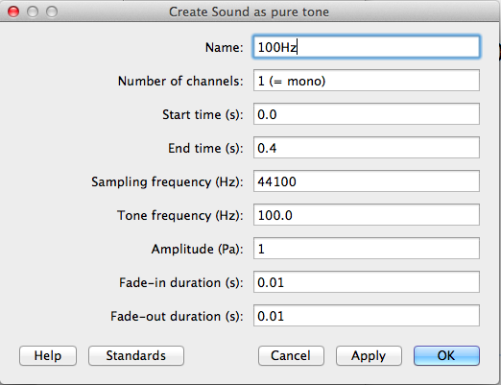
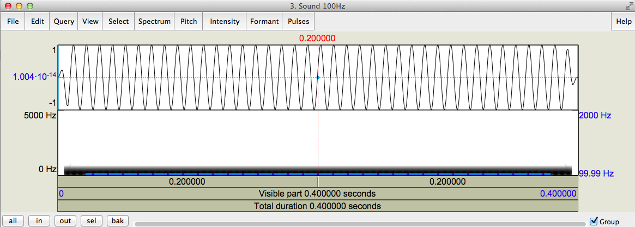
Synthesizing Source
Create Sound as pure tone
Frequency: 100Hz
Amplitude: 1

Slide 38
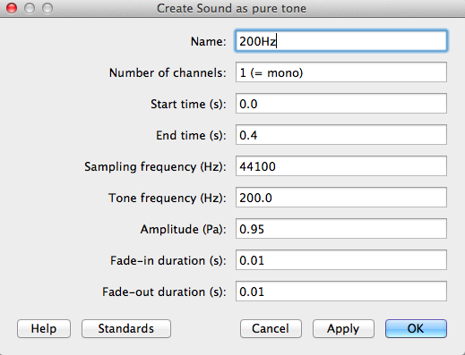
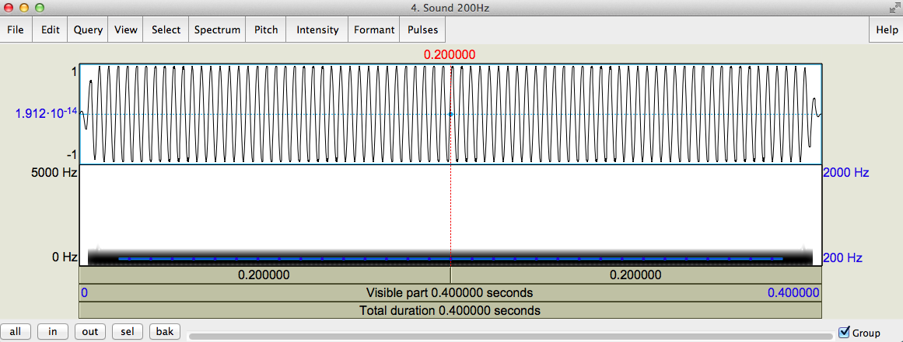
Synthesizing Source
Create Sound as pure tone
Frequency: 200Hz
Amplitude: 0.95

Slide 39
Synthesizing Source
Create pure tones
with different frequencies and amplitudes
Combine to stereo
Convert to mono

Slide 40
Synthesizing Source
Open complex100to1000Hz.collection in Praat
Plot a spectrum
Measure pitch

Slide 41
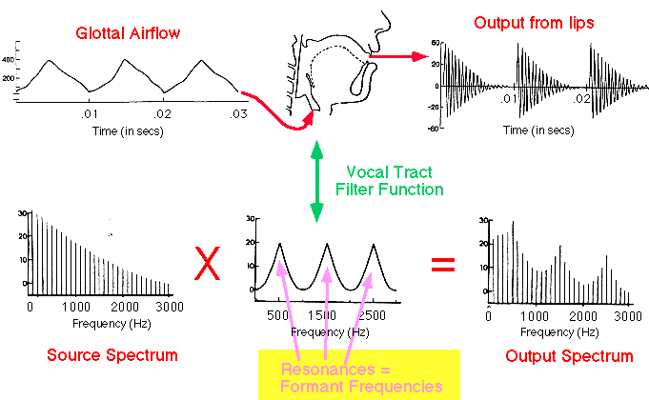
Source-filter theory (from larynx) (by vocal tract) .
Voice Source
waveform
spectrum

Slide 42
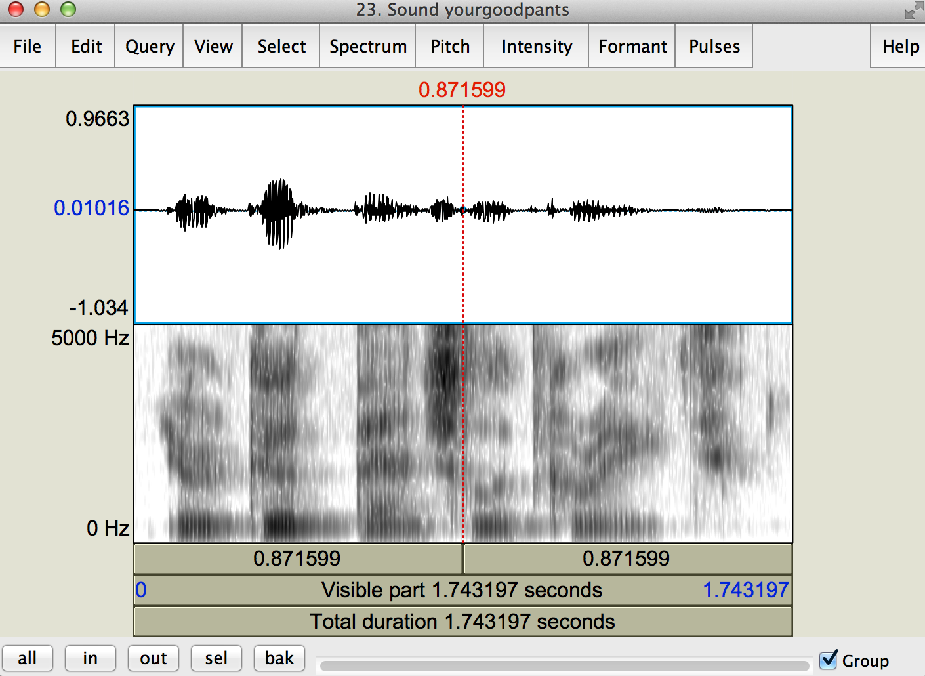
Spectrogram
waveform
Spectrogram
Temporal concatenation of spectrum!!

Slide 43
Spectrogram
F1
F2
F2
F1
Airplane view of temporal concatenation of spectrum!
Dark band: mountains = Formants

Slide 44
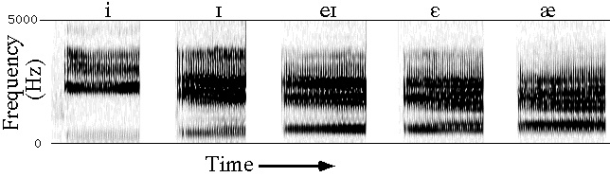
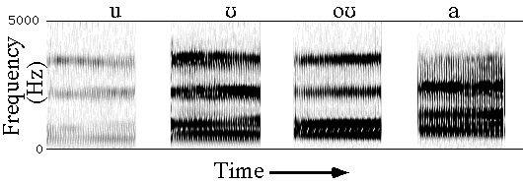
Formants
F1 and F2 are enough to disambiguate vowels.

Slide 45
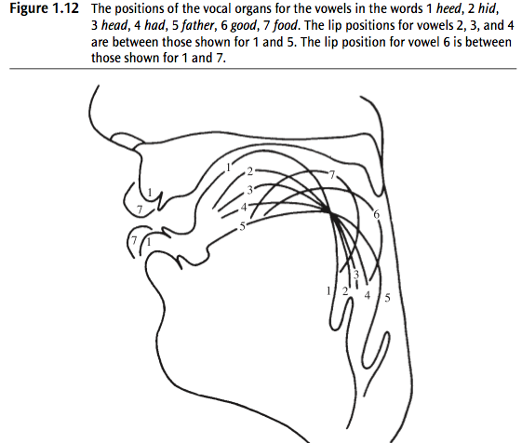
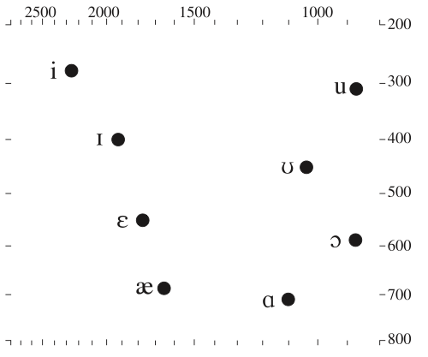
Vowel space
F2
F1
Practice with VowelEditor in Praat

